Slide 1




University of Barishal
Presenting To:
Dr. Rahat Hossain Faisal
Associate Professor
University of Barishal
Presenting By:
Abu Raihan
Roll:02-abu Raihan-office-35
University of Barishal

Slide 2
Stability of cis and trans decalin

Slide 3

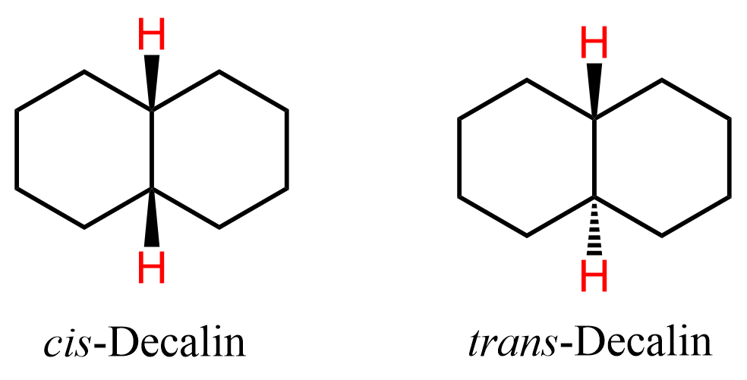

Decalins
Decalin is two cyclohexane rings fused at a common C-C bond. Two diastereoisomers are possible, depending on whether the hydrogen atoms at the ring junction are cis or trans.

Slide 4

When a cyclohexane ring inverts, the substituents that were equatorial become axial and vice versa. This is fine for cis-decalin, which has an axial-equatorial junction, but it means that ring inversion is not possible for trans-decalin. For trans-decalin to invert, the junction would have to become axial-axial, and it's not possible to link the axial positions to form a six-membered ring. Since it does not undergo ring flipping, it remains rigid and is more stable than cis-decalin.
Structure and stability:
Cis-decalin
Trans-decalin

Slide 5


Cis-decalin-can undergo a ring flip
Green H starts axial on black ring, blue H starts equatorial on blacking ring
After ring flipping, green H is equatorial on black ring, blue h is axial on black ring

Slide 6
Impossible to join two axial positions into six membered ring
In the trans fused conformation rotation is not possible, so configuration is going to be fixed .So , that’s why it is highly stable.

Slide 7

Thank You

